Slide 1

VOICE RECOGNITION AND EMAIL BASED HOME AUTOMATION SYSTEM USING RASPBERRY PI
APURVA PANIDHAR 2210411204
DN GAURAV RAJ 1210411114
PATLURI SRI CHAITANYA 2210411246
SAHITHI MANAM 2210411252
UNDER THE GUIDANCE OF:
Mr. B. SAMMUNAYAK _{M.Tech}
ASSISTANT PROFESSOR
GITAM UNIVERSITY
HYDERABAD CAMPUS

Slide 2
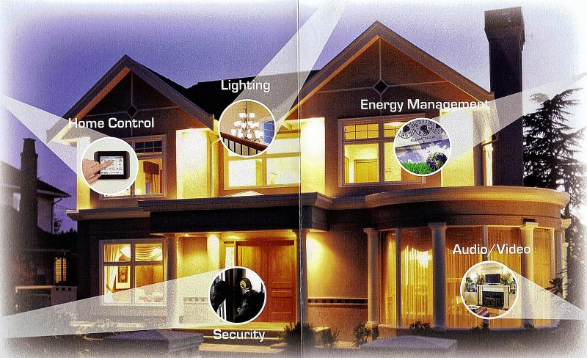
HOME AUTOMATION
Automation of household activities or centralized control

Slide 3
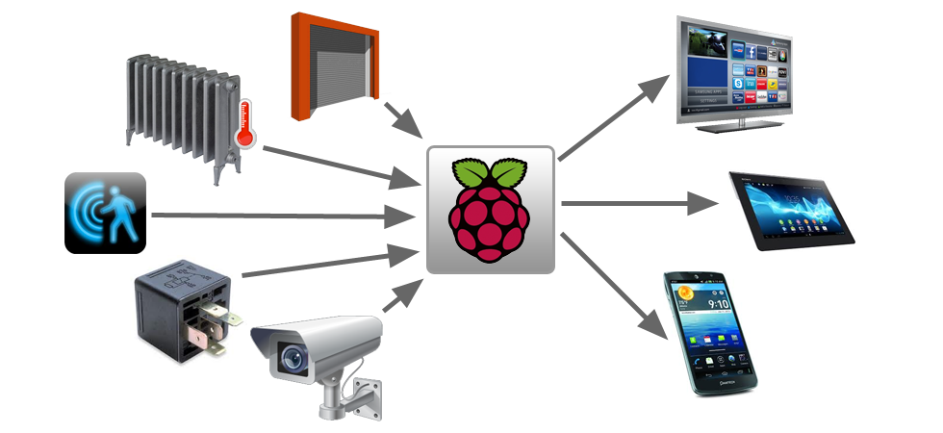
PROJECT AREAS OF FOCUS
Home automation with raspberry-pi at the crux
Voice recognition system
Email based system

Slide 4
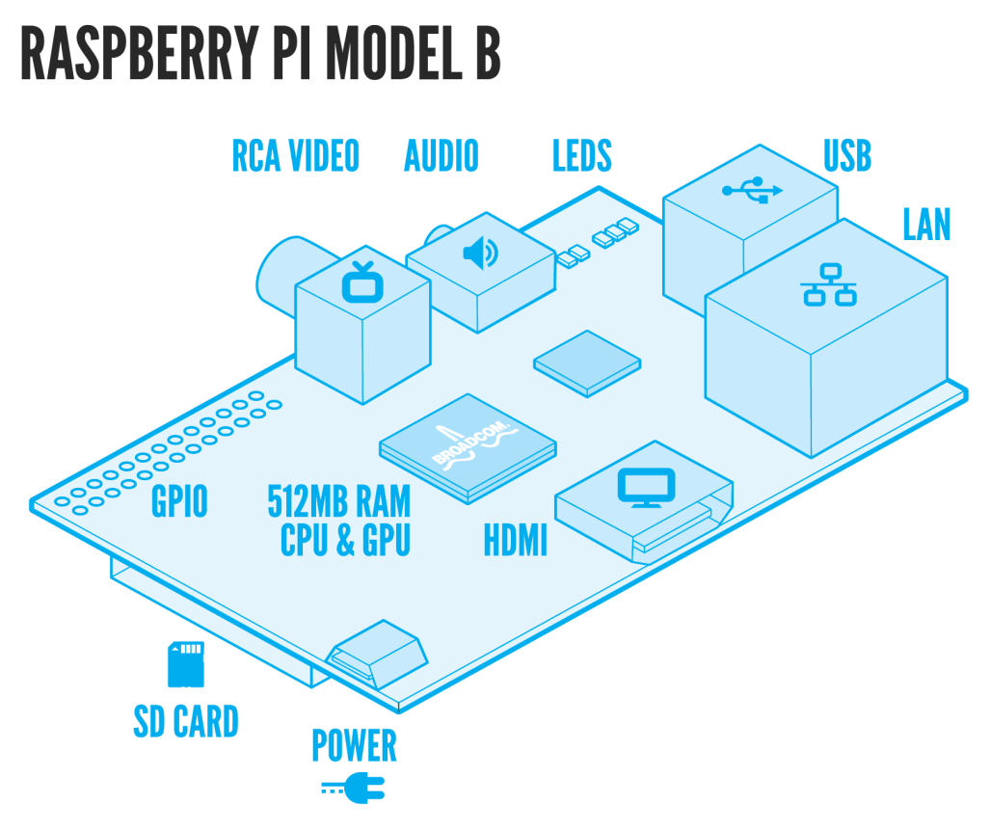
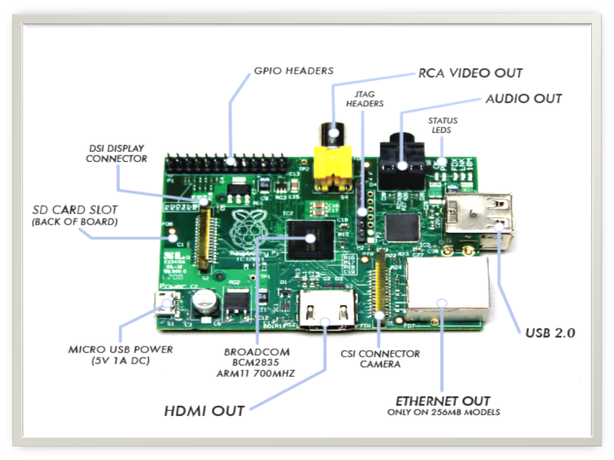
RASPBERRY PI-1
Developed in UK by Raspberry-pi foundation in 2009.
supported by “University of Cambridge Computer laboratory & Broadcom”
Credit card size single board ,super low cost computer
The Foundation has produced two models

Slide 5
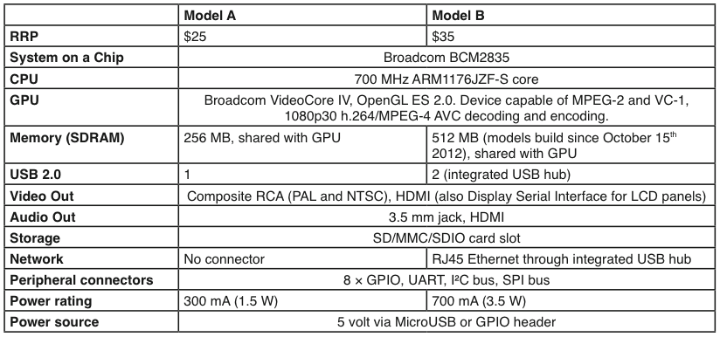
RASPBERRY PI-2

Slide 6
RASPBERRY PI-3
Advantages
Lower power consumption
Low cost
Small size
Applications
Home Automation System
Security System
HD surveillance system
Media Center
GPIO based

Slide 7
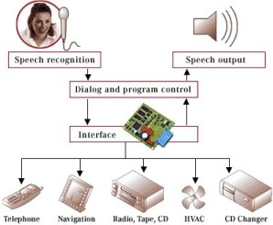
VOICE RECOGNITION SYSTEM-1
Enables user to control home appliances with voice commands when in the home
Implies that the system can only take dictation and not understand words
So you talk and your electronics listen!

Slide 8
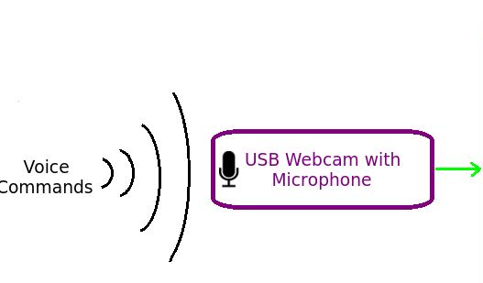
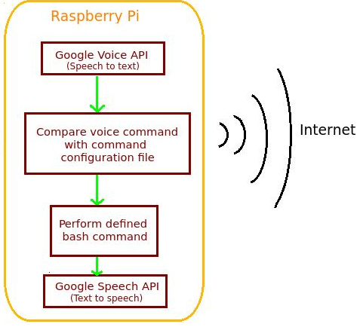
VOICE RECOGNITION SYSTEM-2
Jasper
An open source platform to develop voice controlled applications
A software similar to Siri in iOS

Slide 9
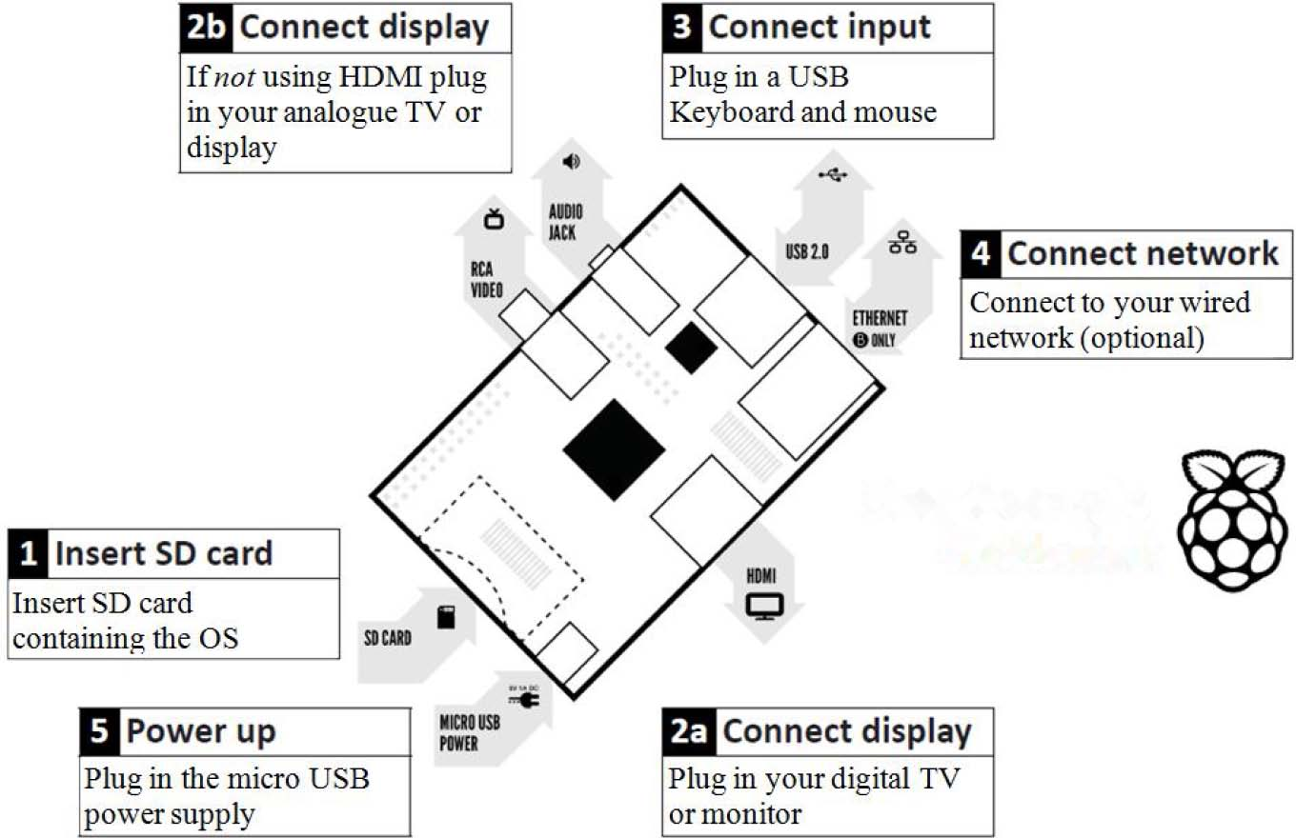
EMAIL BASED SYSTEM-1
Description of RPi Board

Slide 10
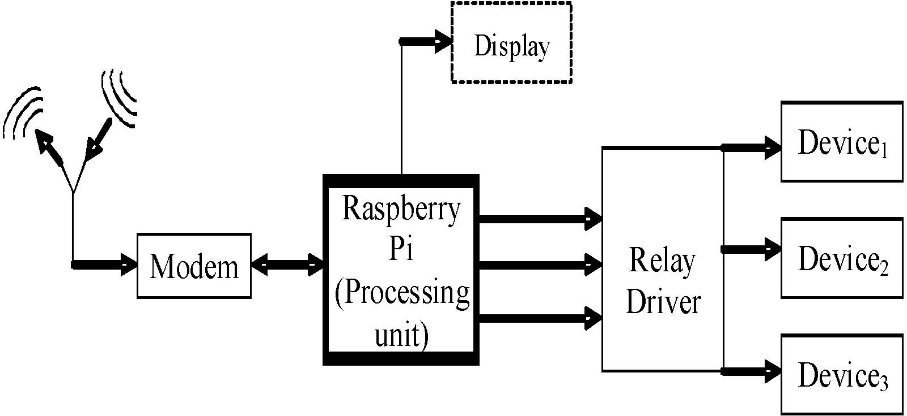
EMAIL BASED SYSTEM-2
Layout of proposed system configuration

Slide 11
EMAIL BASED SYSTEM-3
System Configuration
Raspberry pi-Processing unit
Feed the Python coded algorithm into the Raspberry pi
Connect the Raspberry pi to the Internet through MODEM
Relay driver circuit interfaces the Raspberry pi to the devices to be controlled
Display is optional

Slide 12
EMAIL BASED SYSTEM-4
Steps Involved
Initializing the code and logging into home Gmail account
Raspberry pi reads the subject of the e-mails from the account specified in the code
Comparison of the subject of the e-mail from the initializing commands of the interfaced devices
Control signal generated on the GPIO pins
Process continues at an interval of specified time.

Slide 13
SCHEDULE FOR THE YEAR
7Th Semester
Assembly of Equipment
Running Linux on the RPi and checking it’s Functionality
Connecting the Electronic and Electric devices to the system
Learning Python Scripting Language
Coding of Voice Recognition Programs viz Python
8Th Semester
Installation of Jasper Voice Recognition Software
Incorporation of Voice Recognition System
Incorporation of Email based system
Testing the working of the entire system

Slide 14
CONCLUSION
Communication has a tremendous impact on our lives. Home Automation as described in this presentation is now rising as an important area of communication. By means of this project we wish to explore it’s exquisite functionality along with being able to deliver a perspective front of Home Automation.

Slide 15
THANK YOU!

